Slide 1


TACTICAL COMBAT CASUALTY CARE COURSE
MODULE 21: Communication
Module 21: Communication
TCCC TIER 1
All Service Members
TCCC TIER 2
Combat Lifesaver
TCCC TIER 3
Combat Medic/Corpsman
TCCC TIER 4
Combat Paramedic/Provider

Slide 2




Module 21: Communication
TACTICAL COMBAT CASUALTY CARE (TCCC) ROLE-BASED TRAINING SPECTRUM
ROLE 1 CARE
NONMEDICAL PERSONNEL
MEDICAL PERSONNEL
YOU ARE HERE
STANDARDIZED JOINT CURRICULUM
2

Slide 3





Module 21: Communication
1 x TERMINAL LEARNING OBJECTIVES
24
Given a combat or noncombat scenario, perform communication during Tactical Field Care in accordance with CoTCCC Guidelines.
  Identify the importance of and techniques for communicating casualty information with evacuation assets and/or receiving facilities.
  Identify the information requirements and format of an evacuation request.
  Identify the recommended evacuation prioritization for combat casualties.
  Demonstrate the communication of evacuation request information and modified medical information report requirements.
4 x ENABLING LEARNING OBJECTIVES
#
= Terminal Learning Objectives
= Cognitive ELOs
= Performance ELOs
3

Slide 4



Three PHASES of TCCC
Module 21: Communication
1
CARE UNDER FIRE (CUF)
/ THREAT
2
TACTICAL FIELD CARE (TFC)
WORK UNDER COVER AND CONCEALMENT
3
TACTICAL EVACUATION CARE (TACEVAC)
RETURN FIRE AND TAKE COVER
MORE DELIBERATE ASSESSMENT AND PRE- EVACUATION PROCEDURES
YOU ARE HERE

Slide 5
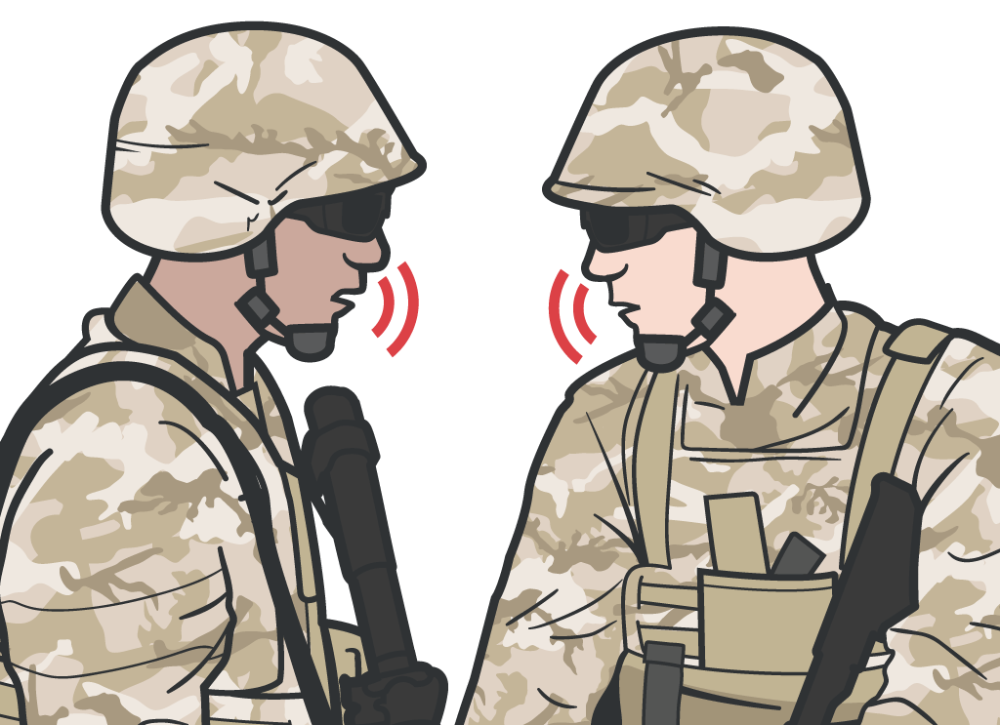
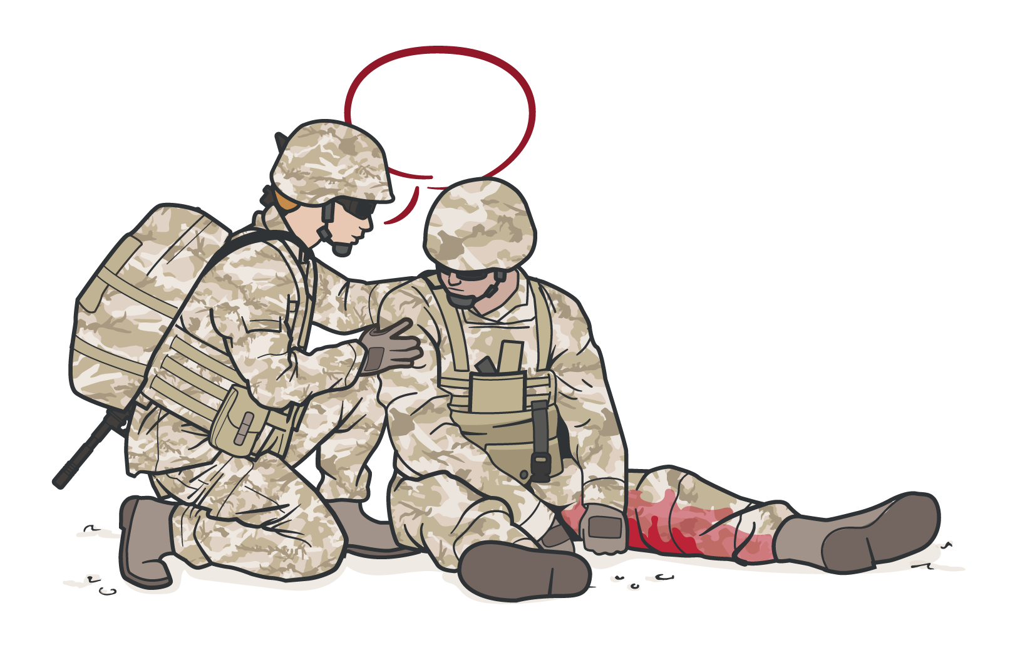
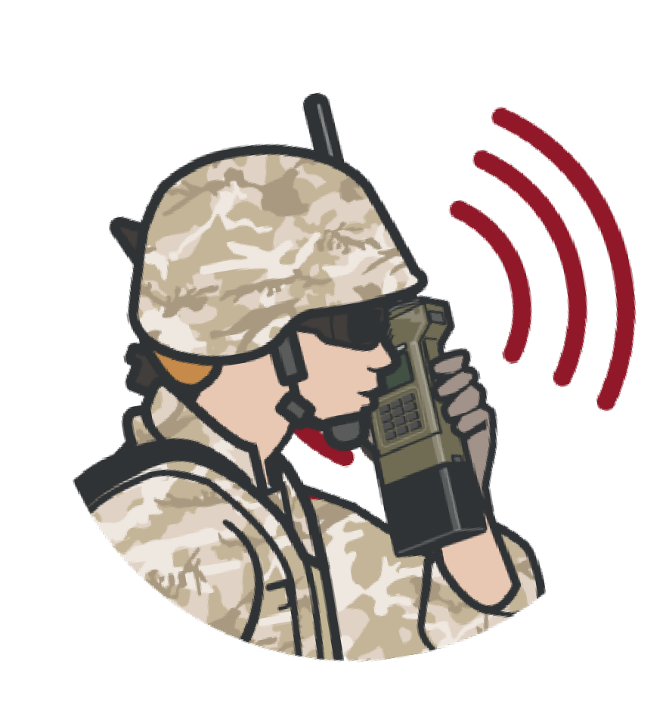
Module 21: Communication
IMPORTANCE
OF COMMUNICATION
Communicate with evacuation
and medical assets
Communicate with
the casualty if possible:
Encourage Reassure
Explain care being given
Communicate with evacuation system to coordinate TACEVAC (CASEVAC or MEDEVAC) using 9-Line MEDEVAC request
MIST report
Keep the casualty’s DD Form 1380
up-to-date
Communicate as soon as possible with tactical leadership and other prehospital medical providers:
Casualty status
Evac requirements and priority Casualty treatment

Slide 6


REQUESTING EVACUATION OF CASUALTIES
Module 21: Communication
CASEVAC:
Unregulated movement of casualties aboard nonmedical aircraft, vehicles, or maritime vessels
MEDEVAC:
Transport by medical personnel of wounded, injured, or ill persons from the battlefield and/or other
locations to Medical Treatment Facilities
Conducted with dedicated medical ground vehicles and aircraft, properly marked with a Red Cross and employed in accordance with the Geneva Conventions and the law of war
ALL personnel should be familiar with how to request medical evacuation as they may need to initiate the request
Depending on the tactical situation, unit standard operating procedures, and available assets, the casualty may be evacuated by MEDEVAC or CASEVAC
TACEVAC is a term that includes both MEDEVAC and CASEVAC in the tactical environment

Slide 7

MEDEVAC/MIST VIDEO 9-LINE ARMY EXAMPLE

Slide 8
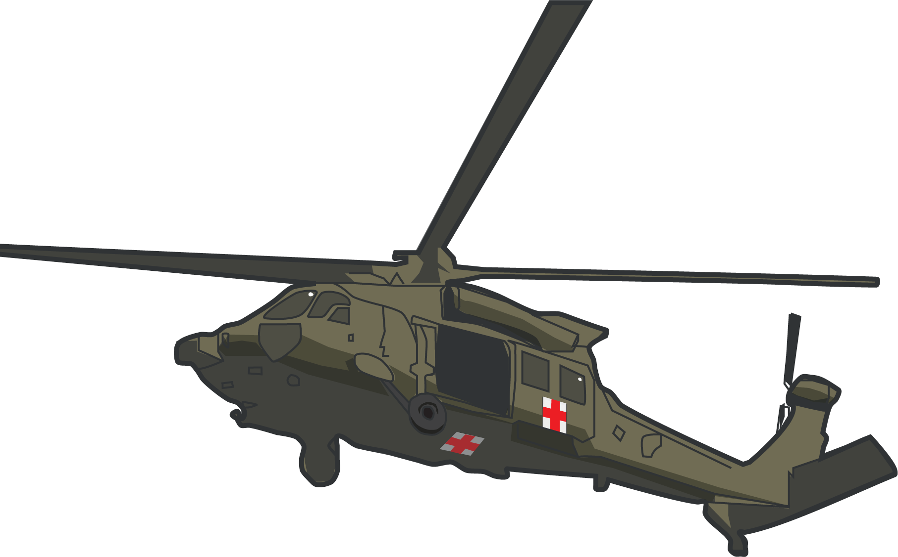

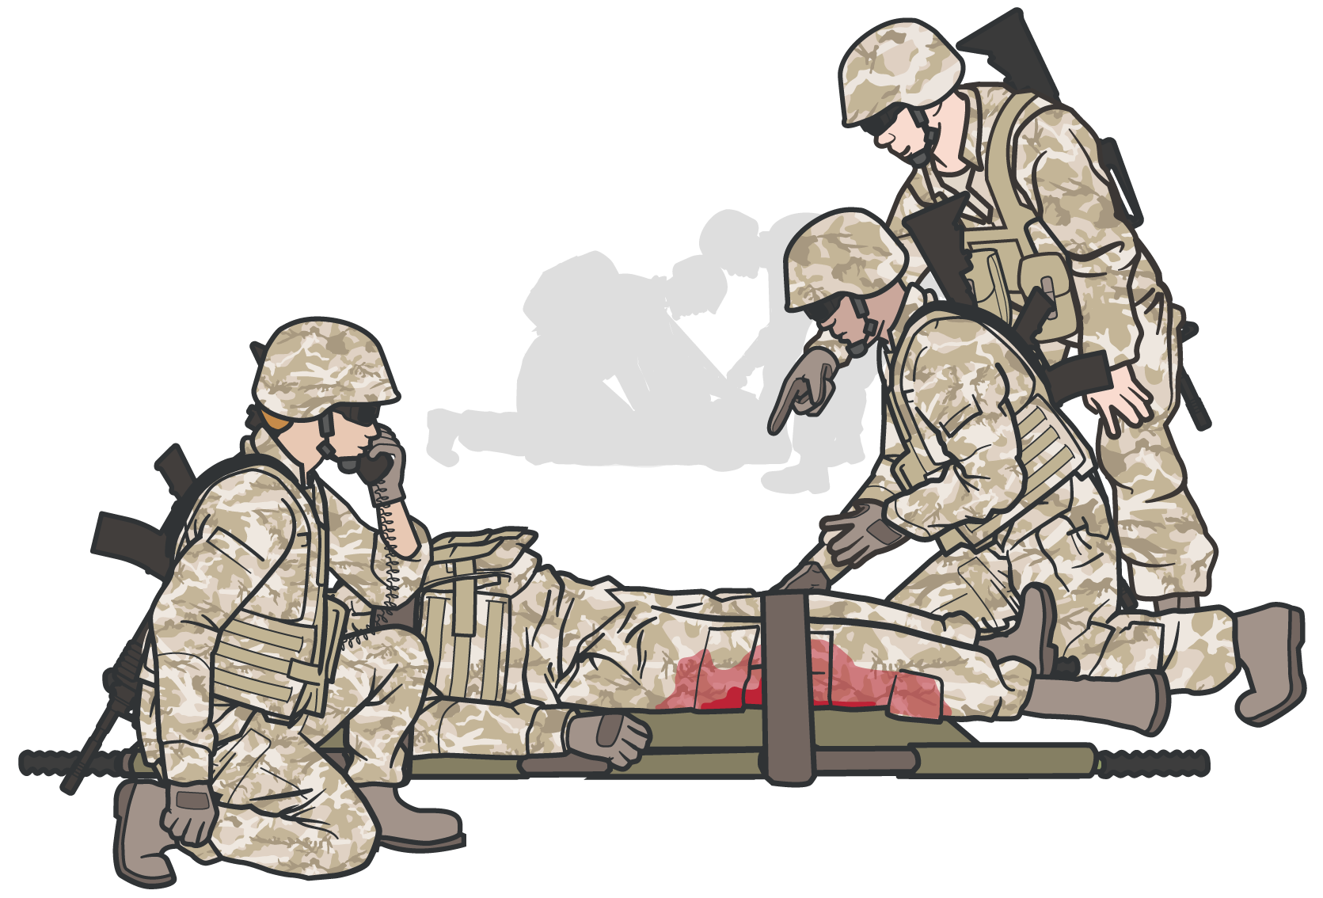
Module 21: Communication
REQUESTING EVACUATION - KEY POINTS
Every SERVICE MEMBER must be prepared to transmit a MEDEVAC request
A MEDEVAC request is NOT a direct medical communication with medical providers, but a means of communicating evacuation requirements so evacuation resources can be launched as needed to support evacuation of casualties
Gather all information needed before initiating transmission of the MEDEVAC request
Use appropriate and mandated communications security and brevity codes when transmitting a MEDEVAC request

Slide 9
Module 21: Communication
NATO CASUALTY EVACUATION CATEGORIES
 | URGENT / Category A | PRIORITY / Category B | ROUTINE / Category C
 | WITHIN 2 HOURS | WITHIN 4 HOURS | WITHIN 24 HOURS
Ex am ple s | Significant injuries from a dismounted IED attack Gunshot wound or penetrating shrapnel to chest, abdomen, or pelvis Any casualty with ongoing airway difficulty Any casualty with ongoing respiratory difficulty Unconscious casualty Casualty with known or suspected spinal injury Casualty in shock Casualty with bleeding that is difficult to control Moderate/Severe TBI Burns > 20% Total Body Surface area | Isolated, open extremity fracture with bleeding controlled Any casualty with a tourniquet in place Penetrating or other serious eye injury Significant soft-tissue injury without major bleeding Extremity injury with absent distal pulses Burns 10-20% of Total Body Surface Area | Concussion (mild traumatic brain injury) Gunshot wound to extremity - bleeding controlled with tourniquet Minor soft-tissue shrapnel injury closed fracture with intact distal pulses
▪
▪
▪
▪ ▪
▪
▪

Slide 10
CASUALTY EVACUATION CATEGORIES
Module 21: Communication
North Atlantic Treaty Organization (NATO) specifies three categories for casualty evacuation:
CAT A
Urgent
CAT B
Priority
CAT C
Routine

Slide 11
CASUALTY EVACUATION CATEGORIES
Module 21: Communication
CAT A
Urgent
(Critical, Life-Threatening Injury)
Significant injuries from a dismounted IED attack
Gunshot wound or penetrating shrapnel to chest, abdomen or pelvis
Any casualty with ongoing airway difficulty Any casualty with ongoing respiratory difficulty Unconscious casualty
Casualty with known or suspected spinal injury
Casualty in shock
Casualty with bleeding that is difficult to control Moderate/Severe TBI
Burns > 20% Total Body Surface Area

Slide 12
CASUALTY EVACUATION CATEGORIES
Module 21: Communication
CAT B
Priority
(Serious Injury)
Isolated, open extremity fracture with bleeding controlled
Any casualty with a tourniquet in place Penetrating or other serious eye injury
Significant soft tissue injury without major bleeding
Extremity injury with absent distal pulses Burns 10-20% Total Body Surface Area

Slide 13
CASUALTY EVACUATION CATEGORIES
Module 21: Communication
CAT C
Routine
(Mild to Moderate Injury)
Concussion (mild TBI)
Gunshot wound to extremity – bleeding controlled without tourniquet
Minor soft tissue shrapnel injury Closed fracture with intact distal pulses Burns < 10% Total Body Surface Area

Slide 14
MIST REPORT
Module 21: Communication
The MIST report stands for:
Mechanism of Injury
(IED, GSW, RPG, motor vehicle crash, fall, etc.)
Type of Injury
(found and/or suspected)
Signs
(pulse rate, blood pressure, respiratory rate)
Treatment Given
(tourniquet, blood, pain meds, etc.)
M I S T
Report
M
May change as the casualty status and interventions performed change
Conveys additional evacuation information that may be required by theater policy
Helps better prepare receiving medical personnel/facility
I S
T

Slide 15

SKILL STATION
Communication (skills)
Module 21: Communication
MEDEVAC Request
MIST Report

Slide 16
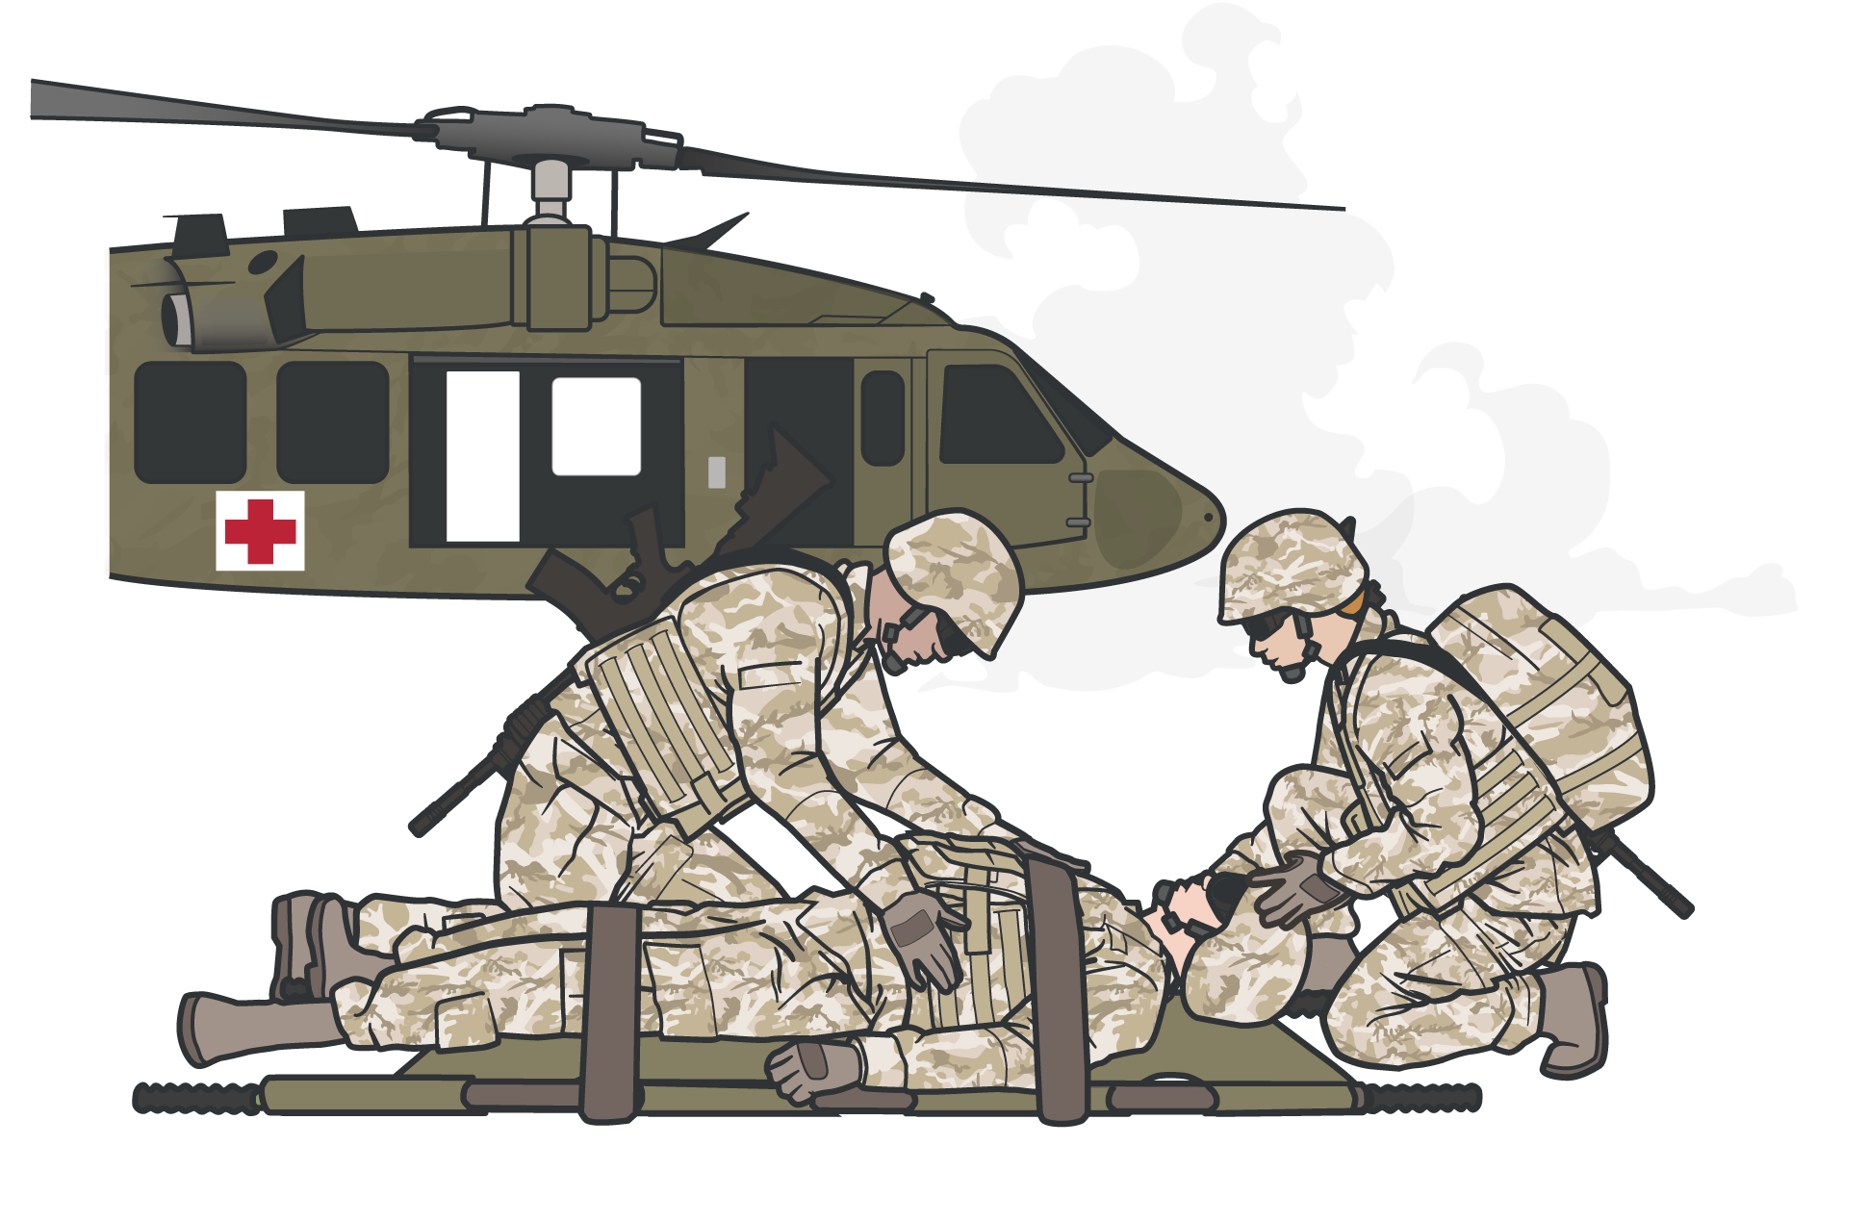
OVER-CATEGORIZATION
Module 21: Communication
OVER-CATEGORIZATION:
the tendency to classify a wound or injury as being more severe than it actually is
A problem both historically AND in current operations
Proper classification is needed to ensure that casualties in greatest need are evacuated first and receive the care needed in an appropriate timeframe to optimize their chance for survival
Timing of evacuation must be balanced with asset availability, tactical situation, etc.
Over-categorization of casualties can result in inappropriate prioritization of evacuation assets despite constraints and risk

Slide 17
TACEVAC PEARLS OF WISDOM
Module 21: Communication
Soft tissue injuries are common and may look bad, but usually don’t kill unless associated with uncontrolled bleeding or airway issues
Bleeding from most extremity wounds should be controllable with a TQ or hemostatic dressing and does not require urgent evacuation
Shock from uncontrolled bleeding or tension pneumothorax not relieved with needle decompression kills and requires urgent evacuation
Casualties with TBI and “red flag” signs/symptoms require urgent evacuation
Despite excellent TCCC, some casualties will not survive their wounds

Slide 18
SUMMARY
Module 21: Communication
Importance of communication in Tactical Field Care
Techniques for requesting casualty evacuation
Information requirements and format
for an evacuation request

Slide 19

CHECK ON LEARNING
Module 21: Communication
Who should a combat medic/corpsman communicate with in the Tactical Field Care phase of care?
What information does the MIST report contain?
True or False? A combat casualty with 25% TBSA burns would be evacuation category A?

Slide 20




Module 21: Communication
ANY QUESTIONS?

Slide 21
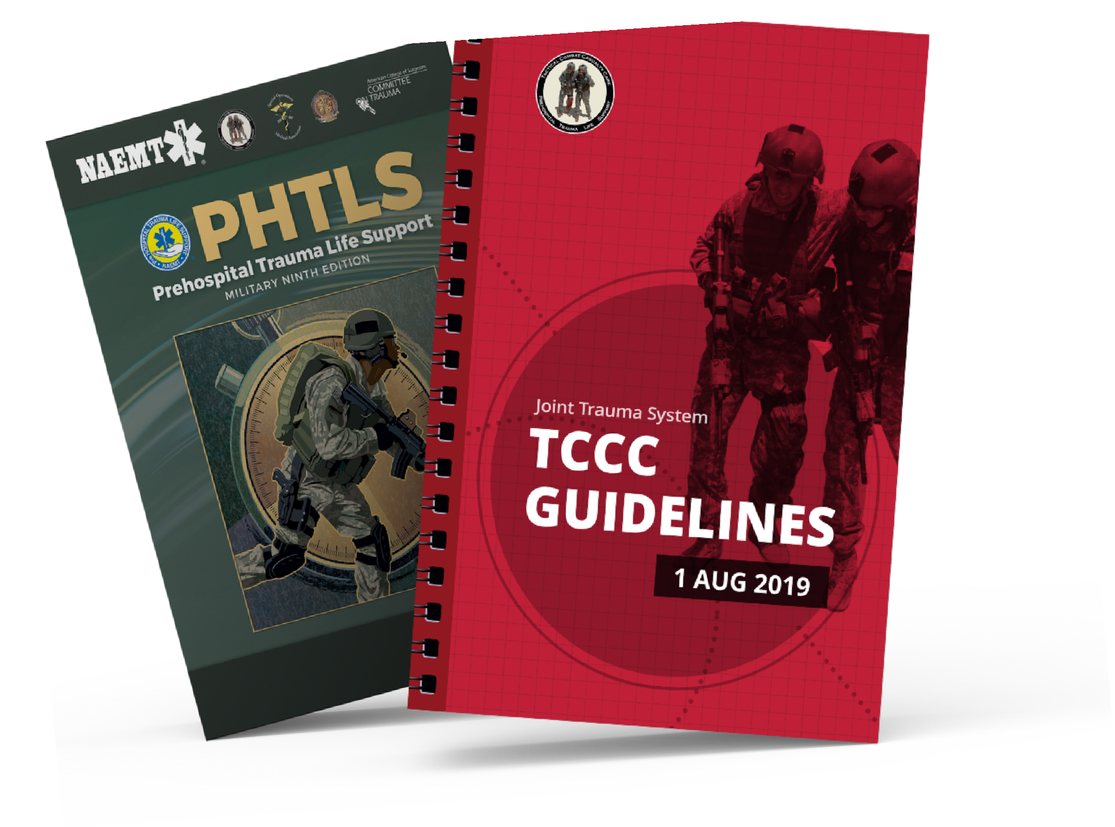
REFERENCES
Module 21: Communication
TCCC: Guidelines
by JTS/CoTCCC
Updated regularly – latest edition dated 5 November 2020
These guidelines are the result of decisions made by the Committee on Tactical Combat Casualty Care as they explore evidence-based research on best practices
PHTLS: Military Edition,
by NAEMT
Prehospital Trauma Life Support,
Military Ninth Edition, teaches and reinforces the principles of rapidly assessing a trauma patient using an orderly approach
NOV 2020

